Slide 1

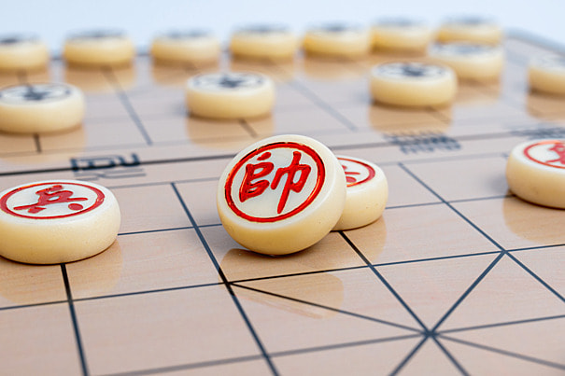

CHINA CHESS
C++ PROGRAMMING
Members:
Hoàng Trung An - 22010740
Nguyễn Đức Bình - 22010960

Slide 2

TABLE OF CONTENT
INTRODUCTION
TARGET FUNCTIONS
TECHNICAL SOLUTIONS
RESULT

Slide 3
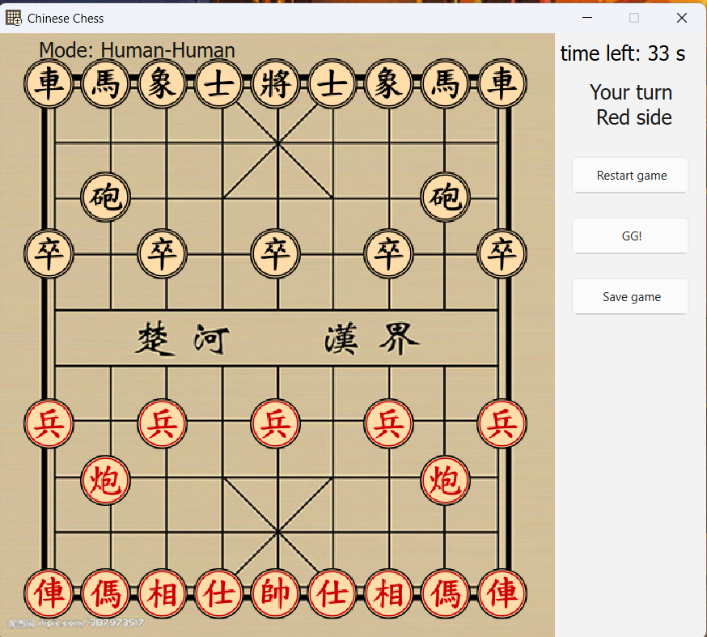
INTRODUCTION
A friendly Two-Player China chess programmed in C++. Move pieces using the mouse, watch out for checks, and aim for checkmate.
1

Slide 4
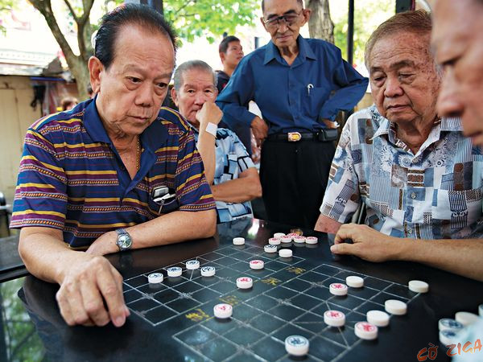
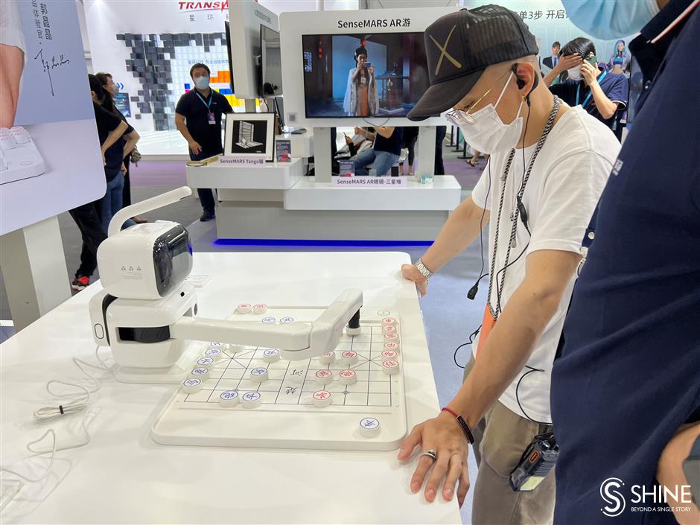
TARGET FUCTIONS
2 Players
Play with AI
2

Slide 5



TECHNICAL SOLUTION
1
Algorithms
UI
3

Slide 6
TIMELINE
Task
W1/Feb
W2/Feb
W3/Feb
W4/feb
W1/mar
w2/mar
Task 1
Task 2
Task 3
Task 4
Task 5
Task 1
Using QT (Trung An)
Task 2
Algorithms of chesspieces movement (Đức Bình)
Task 3
Chess game Programming (Trung An, Đức Bình)
Task 4
Debug & Update (Trung An, Đức Bình)
Task 5
Test & report (Trung An, Đức Bình)
4

Slide 7
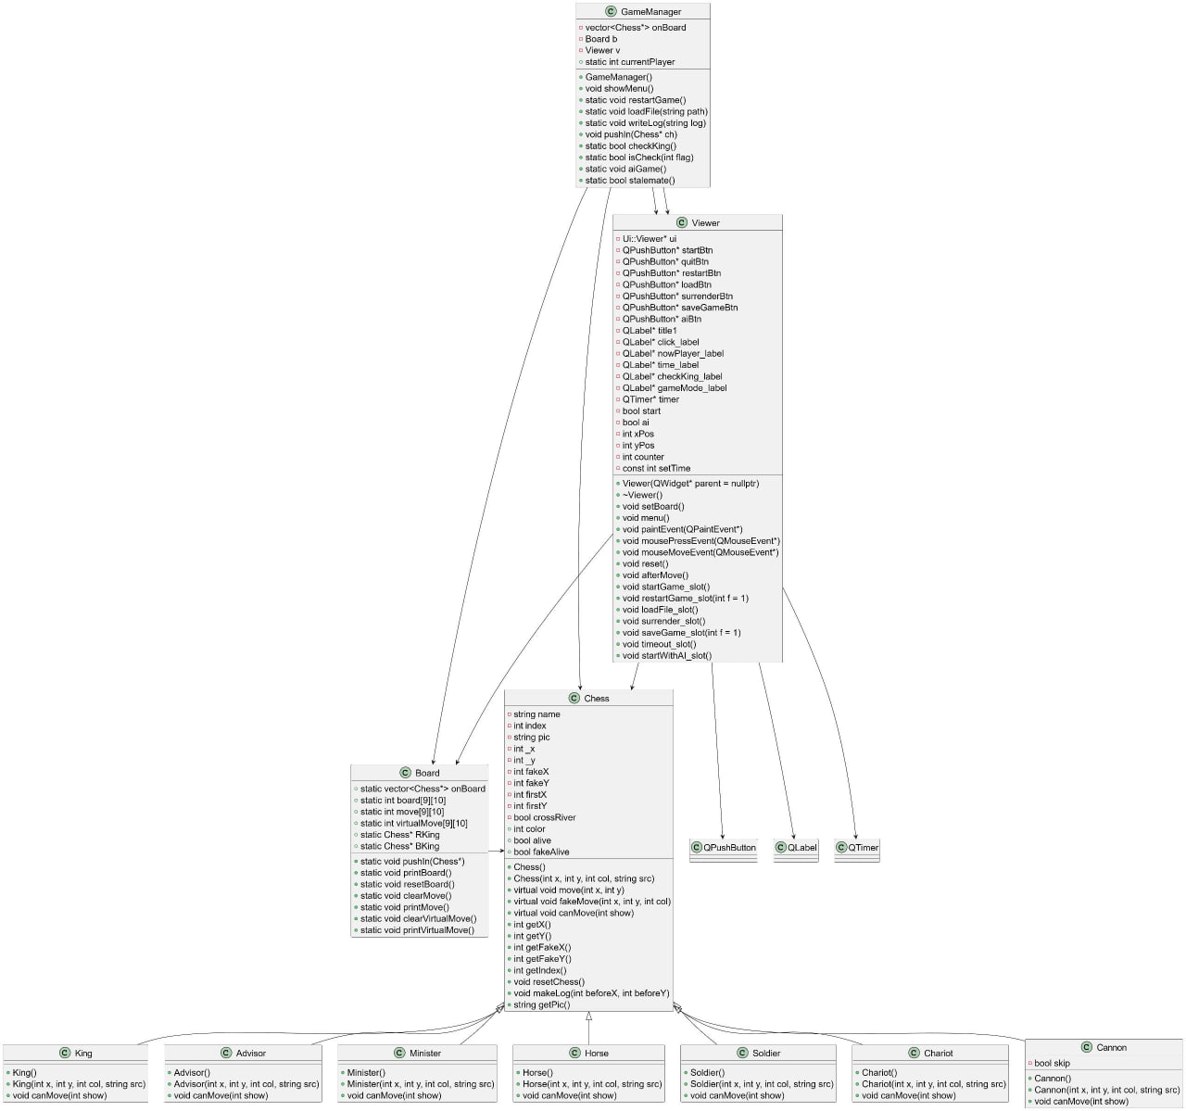
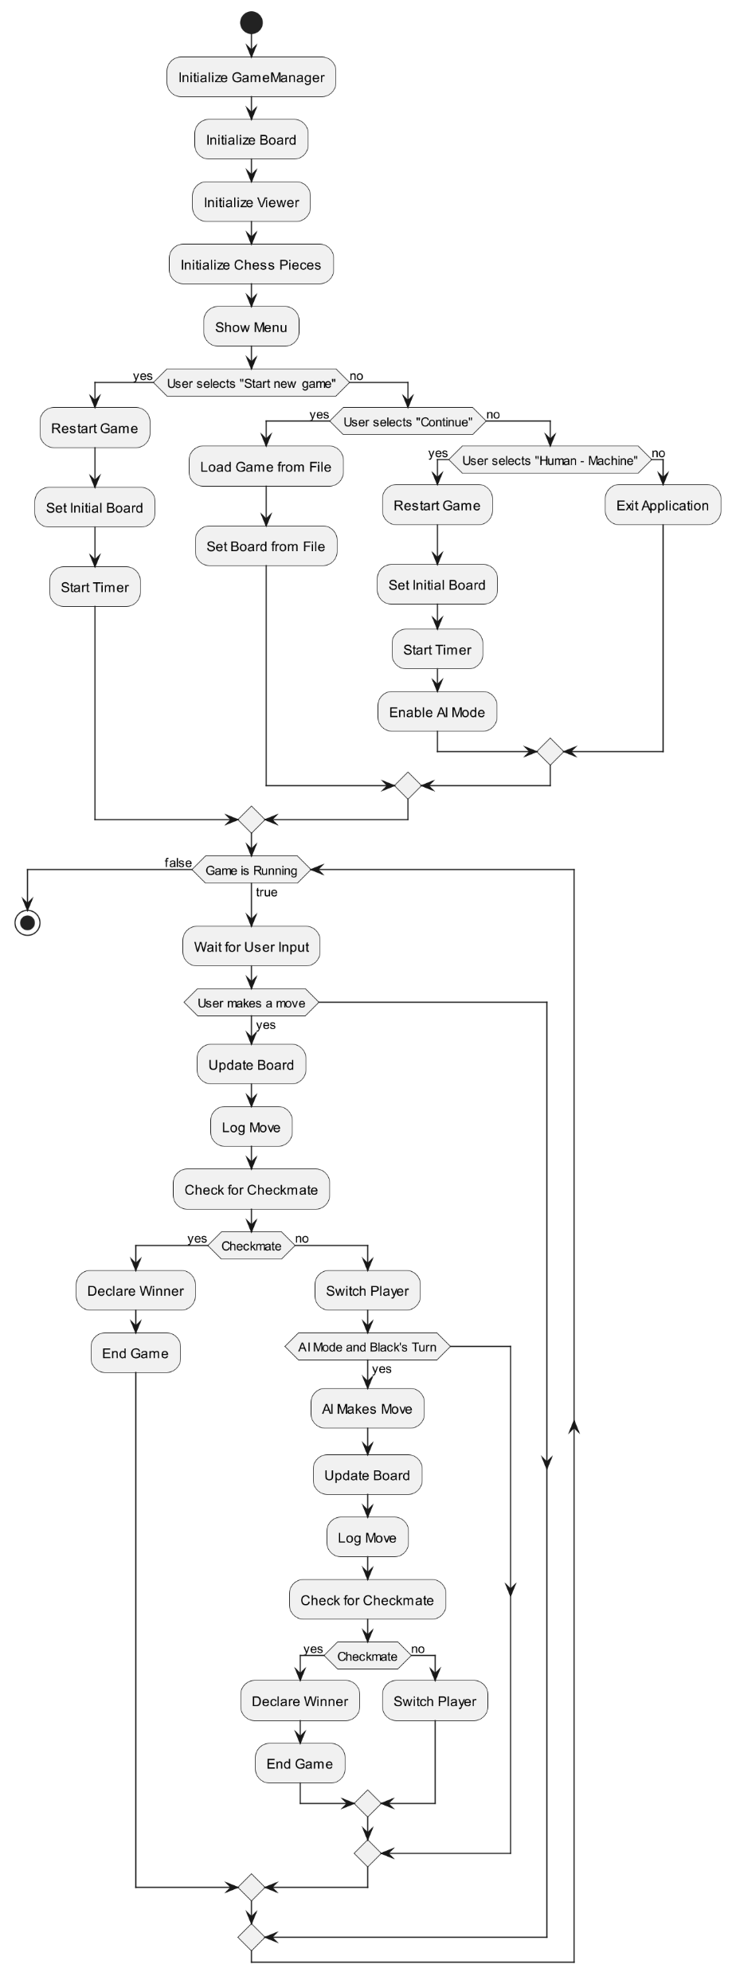
Class diagram and Flow chart solution for chess game project
5

Slide 8
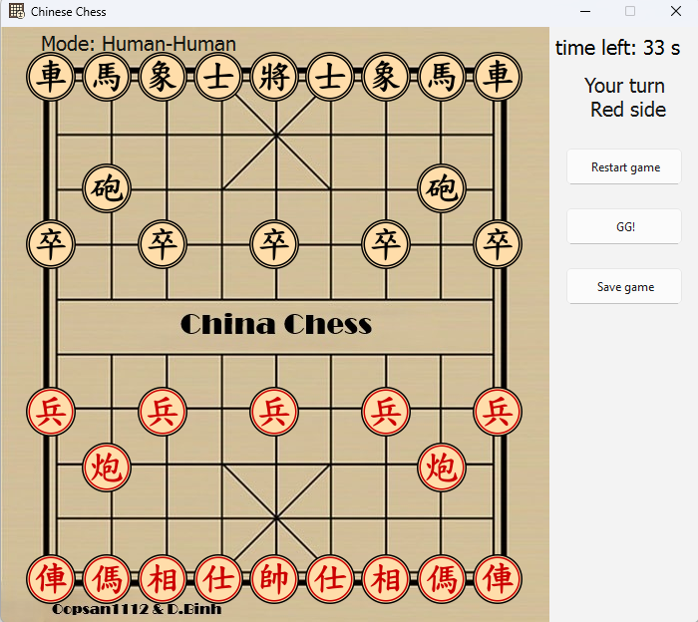
RESULT
Basic chess game on PC 2 players using cusor
6

Slide 9
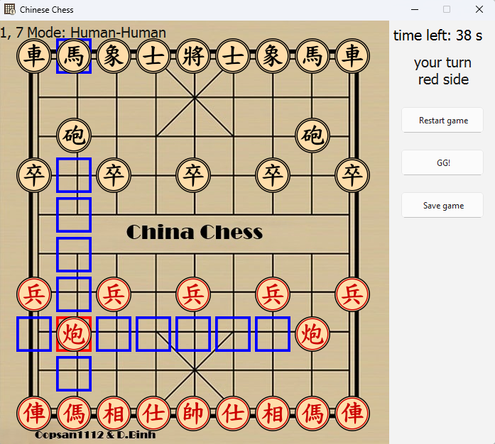
RESULT
Chesspiece movement direction display
7

Slide 10
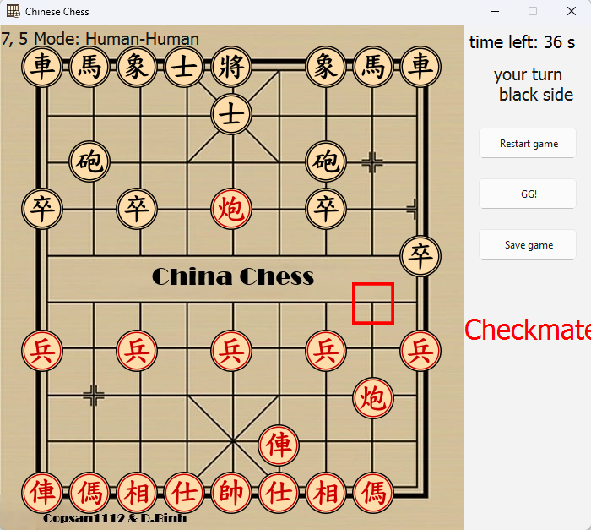
RESULT
King check display
8

Slide 11

RESULT
Mod play with AI
9

Slide 12
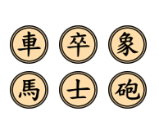
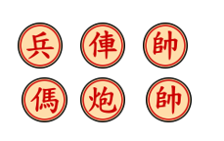
RESULT
Attacked Black Chesspiece
Attacked Red Chesspiece
10

Slide 13
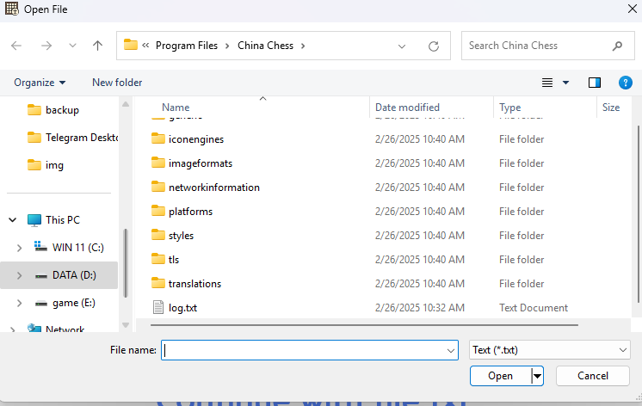
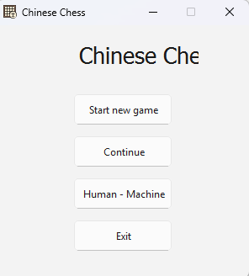
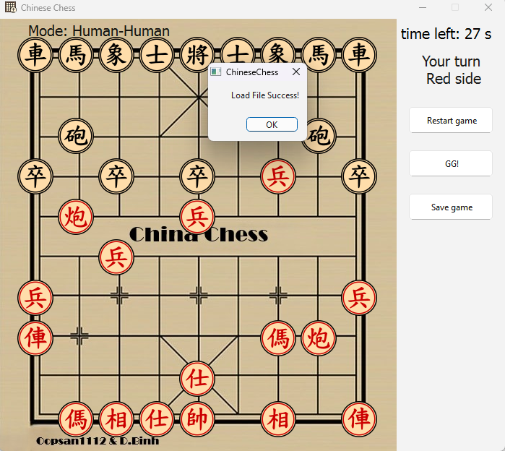
EXTRA
Continue with file txt
11

Slide 14
THANK YOU FOR LISTENING!

